Slide 1
Going for a (model) run
Joren Janzing

Slide 2
Content
General
Preparation for a new model run: - New ice geometry - Which members?
Is the whole system just in balance with long term wind?
Writing overview

Slide 3
General
Only 3.5 weeks to go… What do I still need to do here?
PhD?
Scott?

Slide 4
Preparation for new model run
Took quite some effort… Different format than in matlab code, different area…
Copy and pasted ice and bathymetry outside of the area.

Slide 5
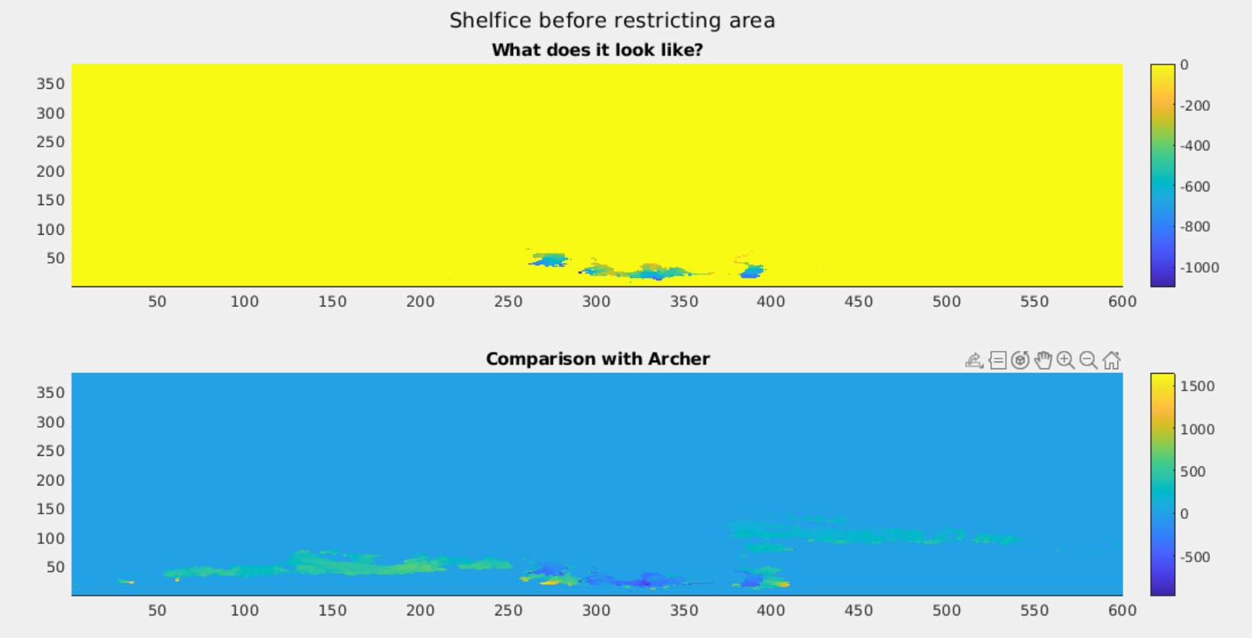

Slide 6
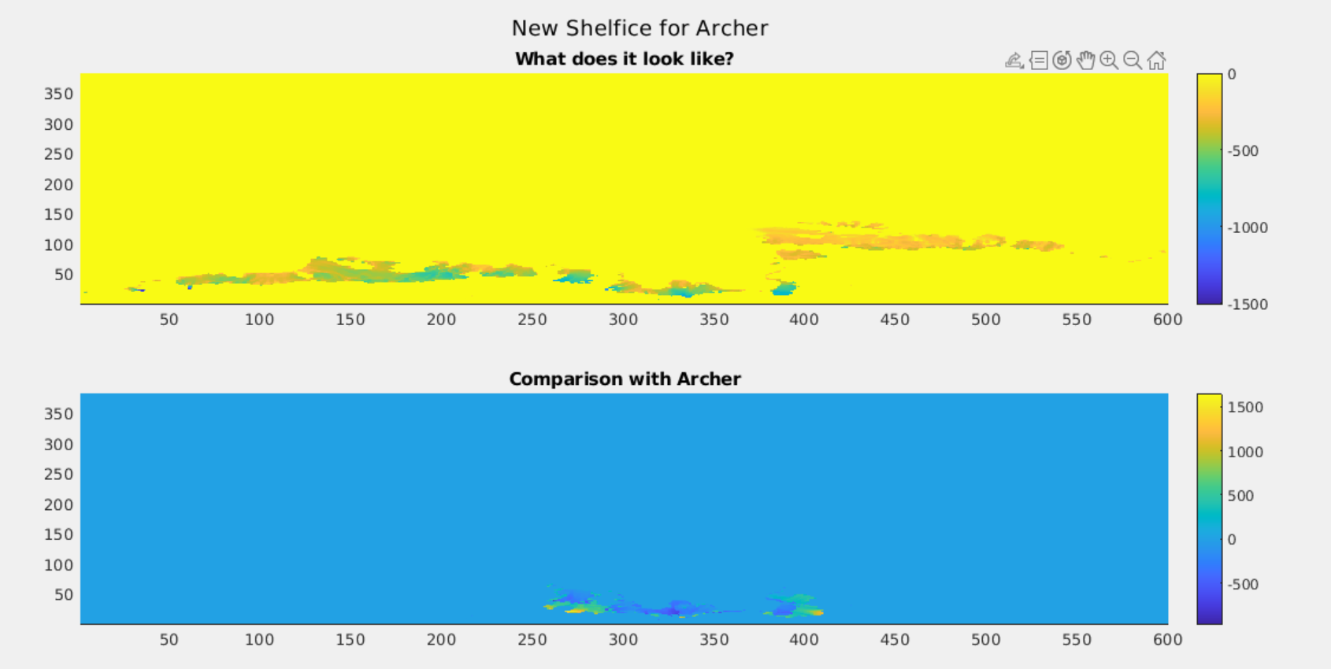

Slide 7
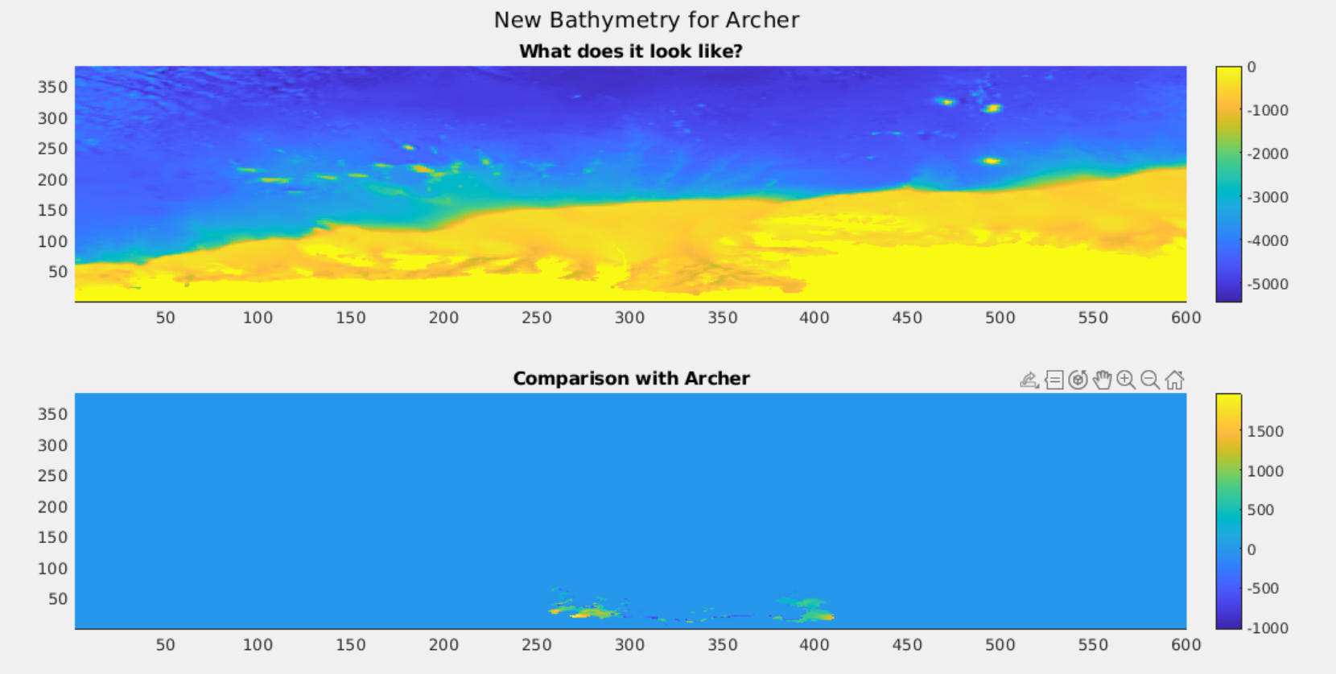

Slide 8
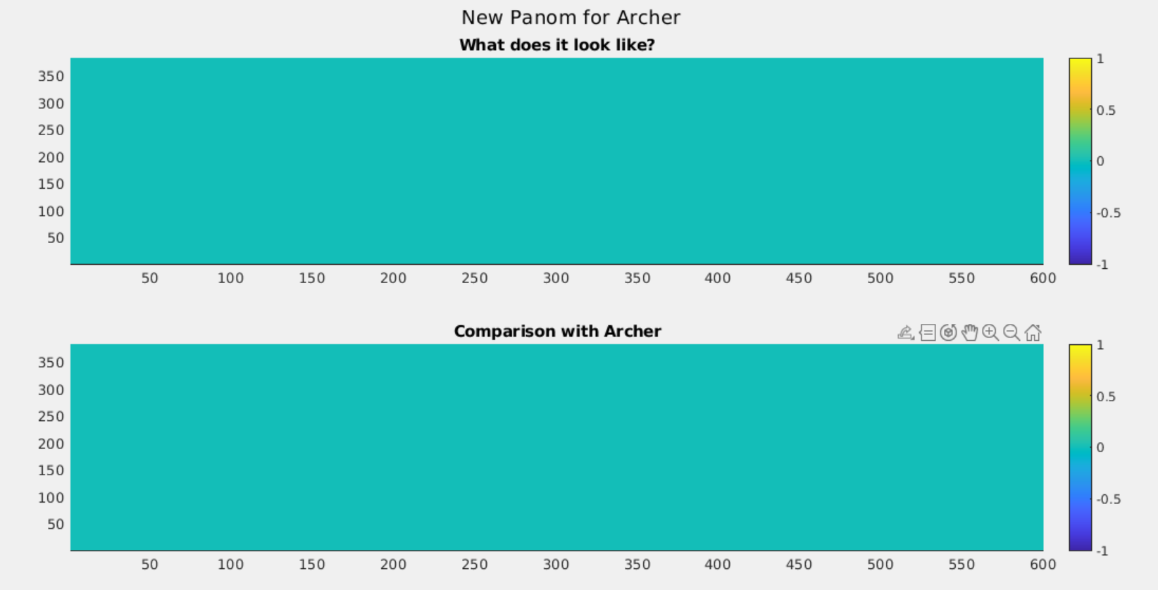
Why is Panom 0?? (also in Archer)

Slide 9
Which members to run in the model?
The reasons for the new run: - study the influence of a change in ice cavity geometry on warm and cold events in the melt and circulation, with a focus on the 1940s in particular.

Slide 10
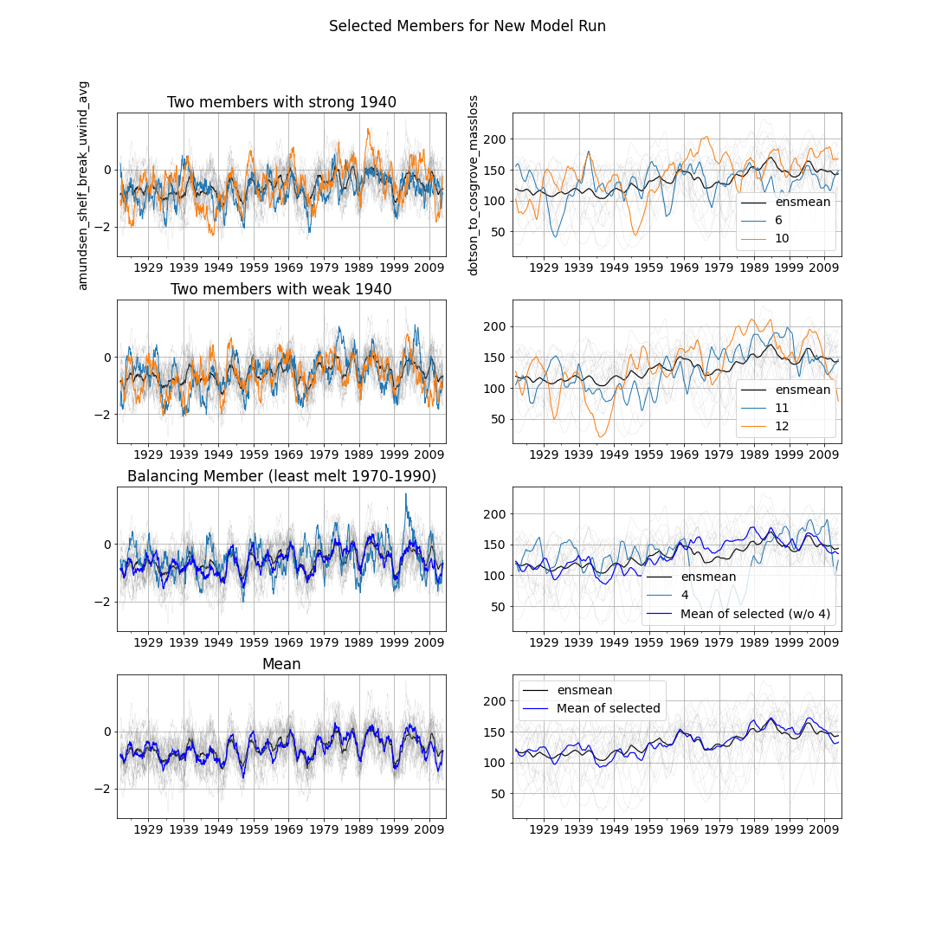
Proposal:
2 members with strong 1940s melt anomaly: members 6 and 10
2 members with weak 1940s melt anomaly: members 6 and 10
1 member to balance the ensemble mean: member 4

Slide 11
Is the whole system just in balance with long term wind?
Surface stress curl might not be the answer…
→ Official definition of oceTAUX:
“oceTAUX [N/m^2]: zonal surface wind stress, >0 increases uVel” https://buildmedia.readthedocs.org/media/pdf/mitgcm/latest/mitgcm.pdf
​
I guess it is relative to surface velocity….
So probably correlations show just the surface velocity…..
It is not a cause, but a consequence….?
New idea: everything is just in balance with long term wind.
Pierre→ everything should have roughly same lag.

Slide 12
Velocity with Melt

Slide 13
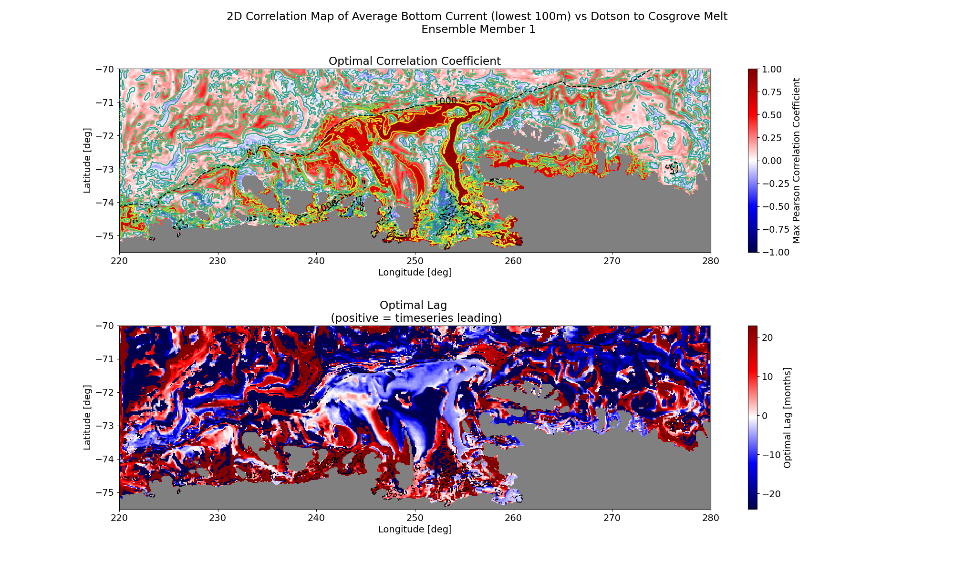

Slide 14
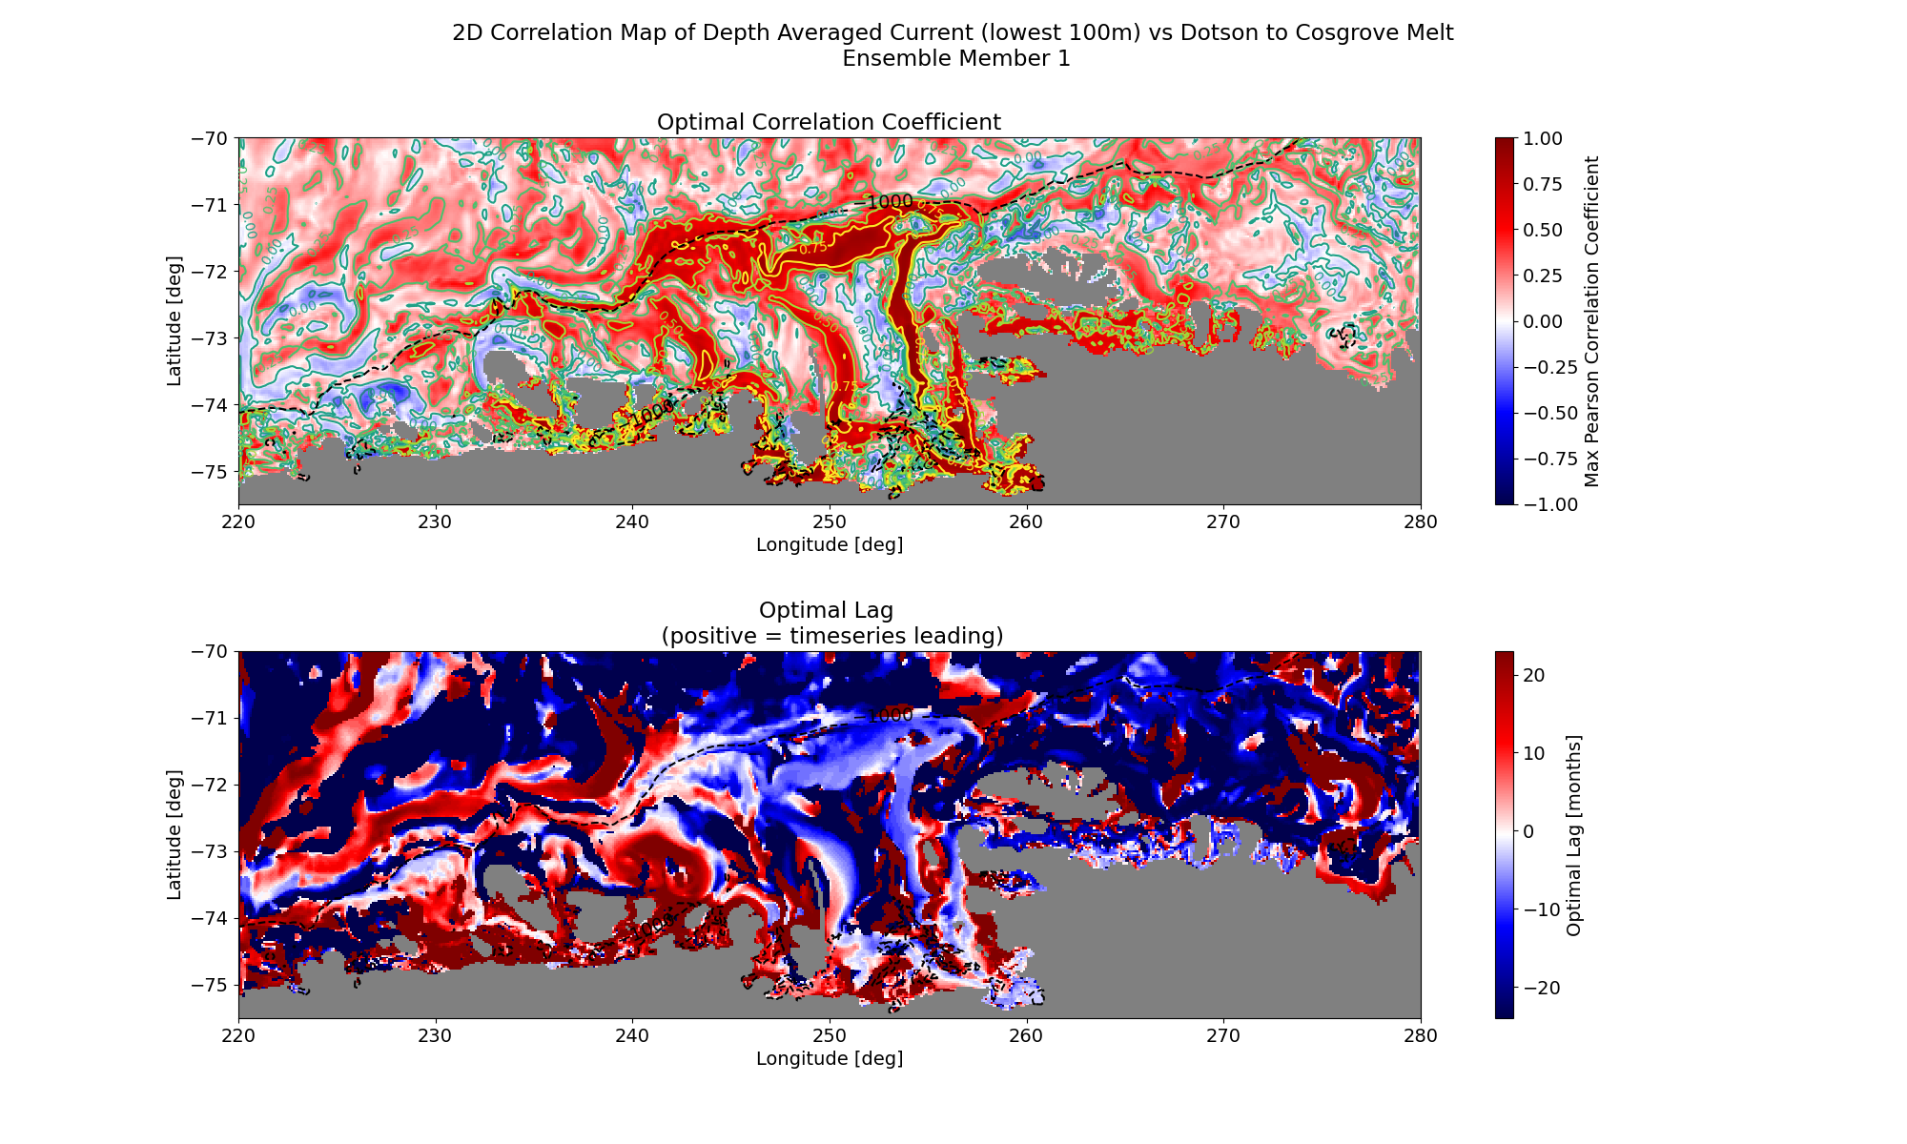

Slide 15
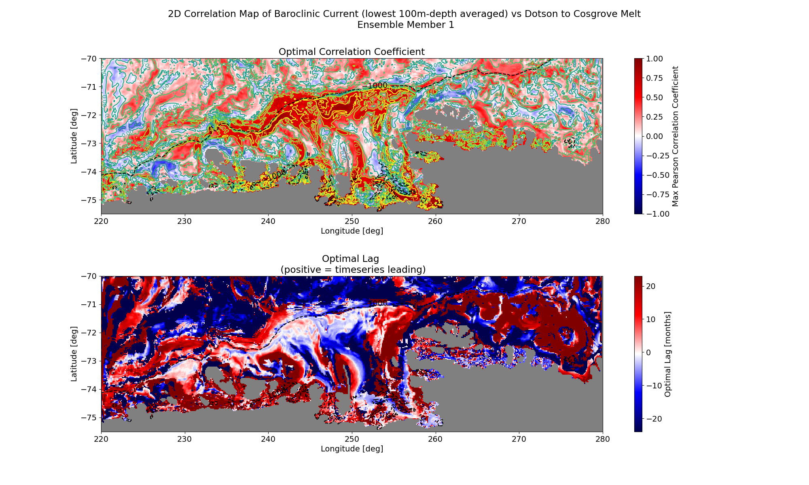

Slide 16
Velocity with Wind (is approximately IPO)

Slide 17
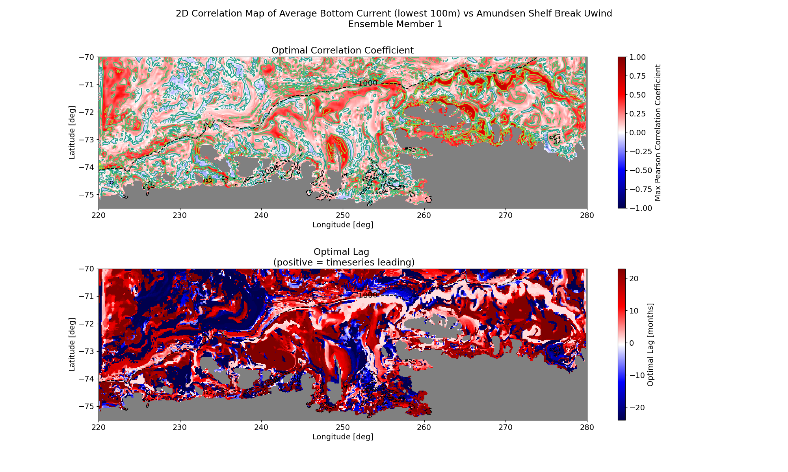

Slide 18
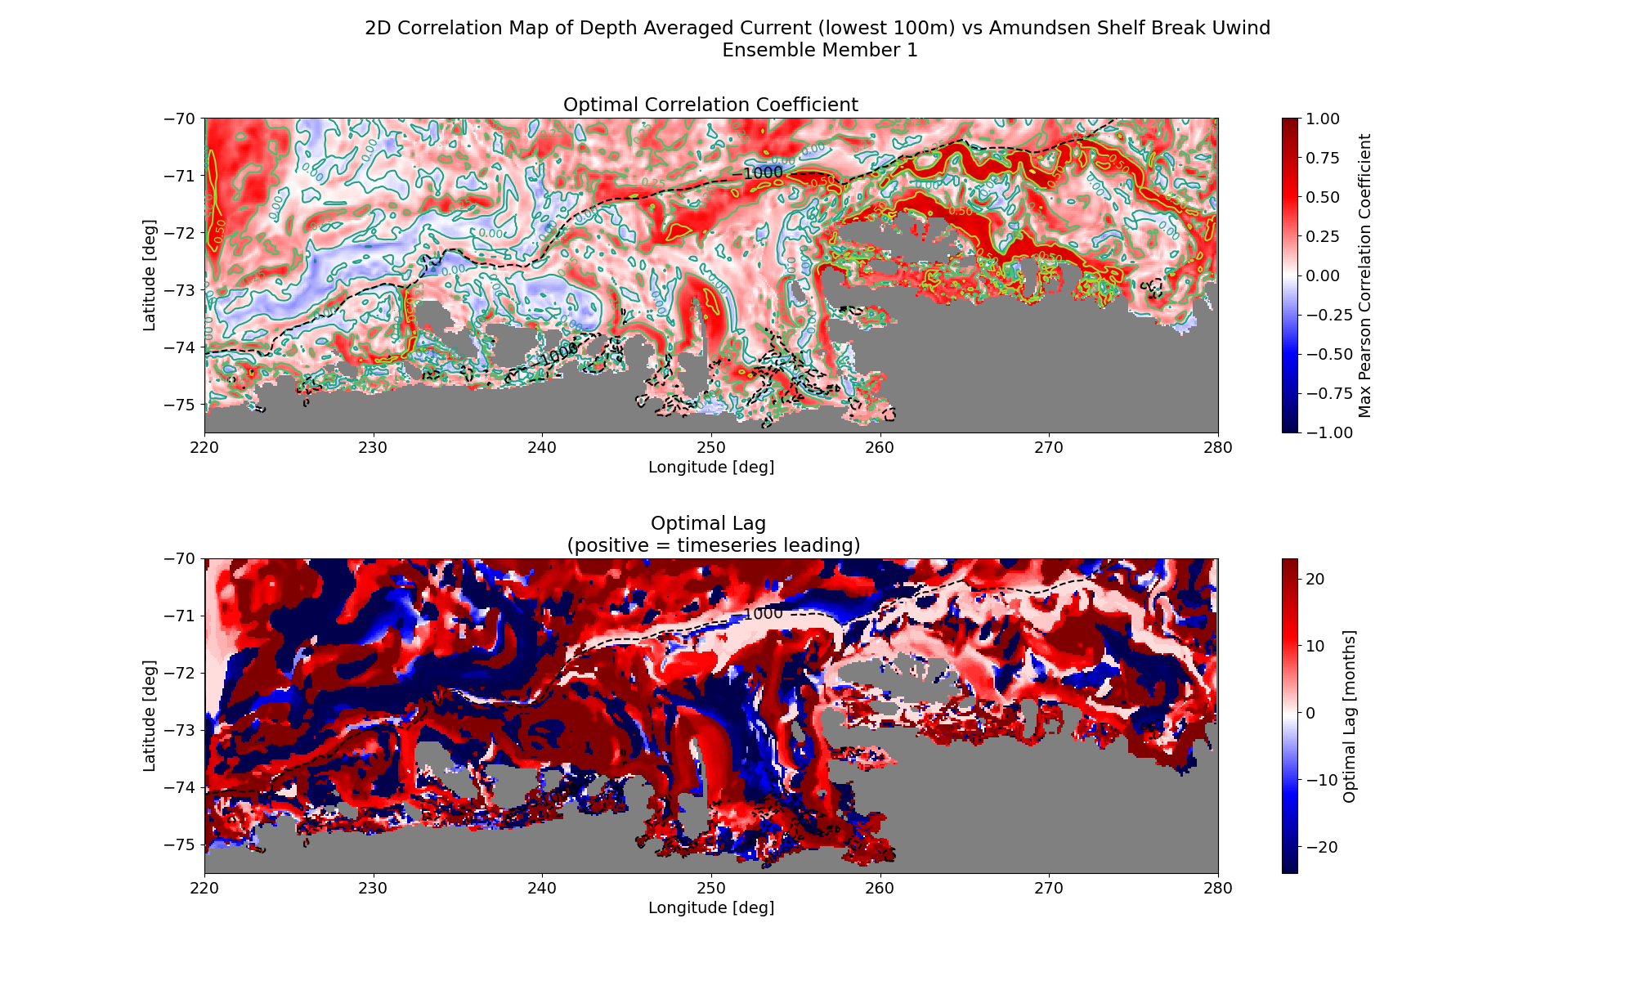

Slide 19
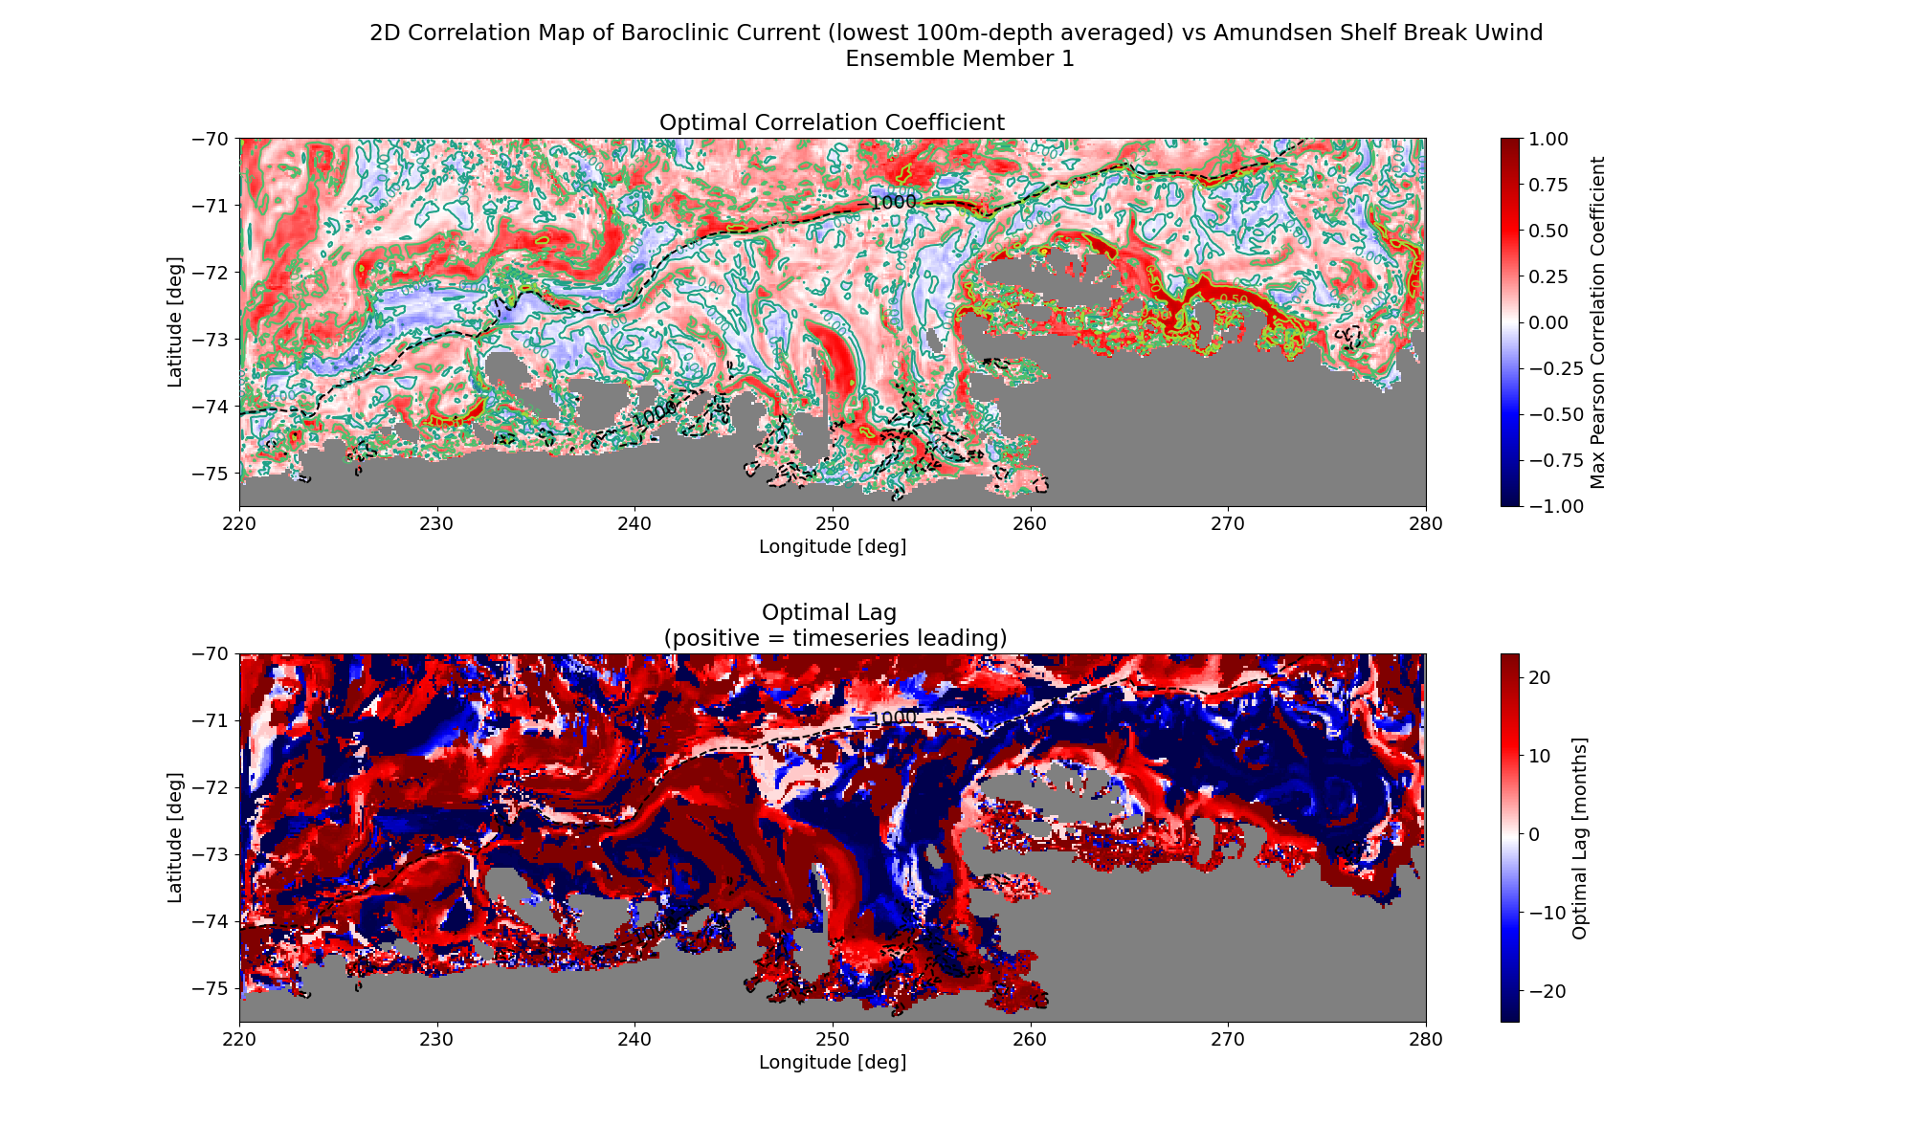

Slide 20
Temperature

Slide 21
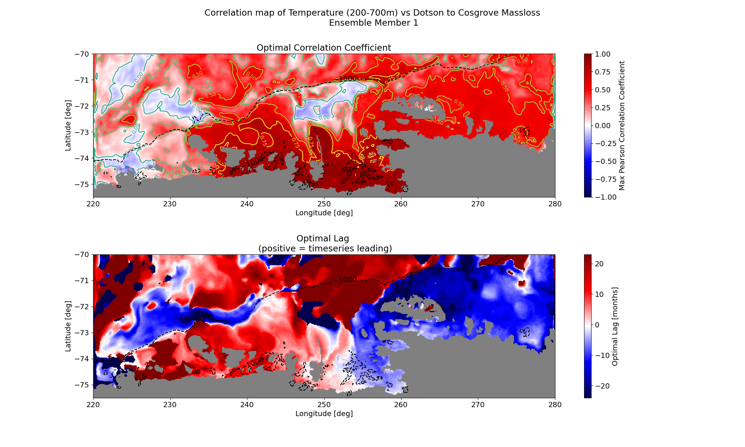

Slide 22
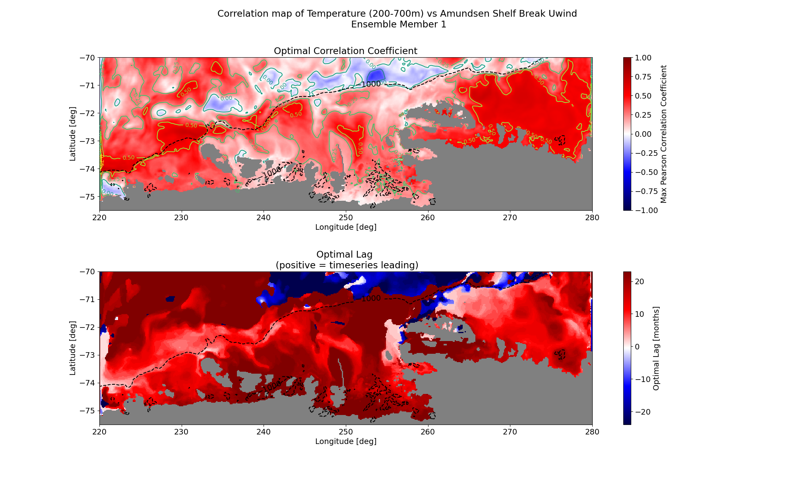

Slide 23
Conclusion
Trough system seems to function as a whole during melt (every place has the same lag in the trough. However, outside of it, this is not the case→ maybe not in balance with the whole system?
Melt correlates best with trough activity, but heat anomaly seems to follow the coast?
Wind does not affect trough flow that much, only local effect, among which the coastal current, shelf break current.
However, wind does not affect temperature at Thurston.
Wind does not seem to take the correct turn.

Slide 24
Conclusion
Hypothesis 1:
The trouble is the corners.
Wind only affects undercurrent, but need something extra to take the corner: → wind curl?
There is not a temperature anomaly that moves, but only an increase in heat. The temperature anomaly therefore just ‘appears’.
Hypothesis 2
trough system functions as a whole
trough system determines THETA anomaly at Thurston.
THETA anomaly is transported by the coastal current.
Wind does not affect the melt directly, because it does not affect the trough enough to set the temperature at Thurston.

Slide 25
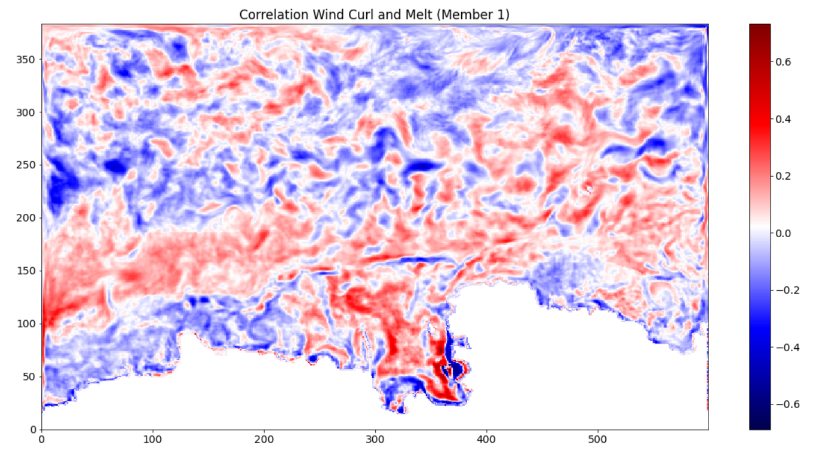

Slide 26
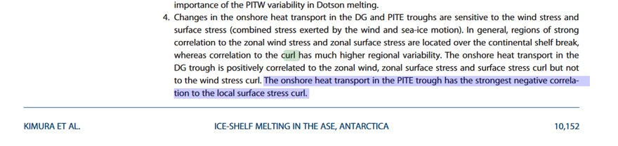

Slide 27
Next steps
Write
Prepare for model run
Add significance to the maps: p_value, some sort of average over all individual ensemble member correlations.
Composites?
Maybe look a bit into conditions strong vs weak 1940s members.

Slide 29
How to test this further?

